Slide 1
PhIAT Documentation -- Manual Fitting
Sam Porter (wporter@triumf.ca)
University of British Columbia TRIUMF, on behalf of the TITAN Collaboration

Slide 2
Overview
Language: MATLAB (R2016a or newer)
Input: A directory address (i.e. address to a folder) of MIDAS Files (ex: /Users/wsporter/Documents/Physics_Research/TITAN/PIICR_Analysis/Testing/Test_CAENOffset) OR a File List.csv (see midas_to_phiat Documentation for more)
Output:
A .csv containing relevant info and potential cyclotron frequencies of spots in all files (if Create Freq ID checked)
A .xlsx containing relevant data fitting results (if Finish Analysis checked)
A .png of the sinusoidal fit of cyclotron frequency data (if Finish Analysis checked)
A .png of the sinusoidal fit of radius data (if Finish Analysis checked)

Slide 3
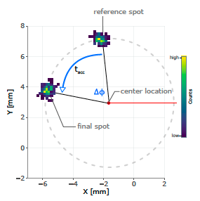
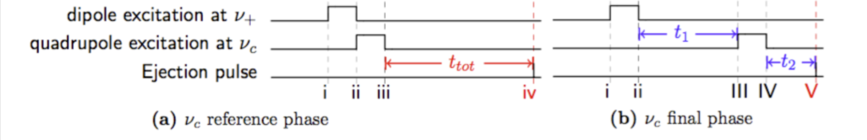

PI-ICR Basics
The cyclotron frequency (⍵_{c}) is determined via the phase difference (ɸ_{c}) between two spots with different accumulation times (Tacc)
Reference Spot: Tacc = 0
Final Spot: Tacc = Nonzero Value
PhIAT determines the X/Y Positions of these spots to find each of their phases

Slide 4
BEFORE YOU CONTINUE! -- titan_data
PhIAT.m uses midas_to_phiat.py, which requires you download the titan_data package
This can be downloaded here: https://bitbucket.org/ttriumfdaq/titan_data/src/master/
On Line 20 in midas_to_phiat.py: Change the address in sys.path.append from '/Users/wsporter/Documents/Physics_Research/TITAN/PIICR_Analysis/titan_data' to the local address of titan_data on your computer (i.e. '/local/address/to/titan_data’)

Slide 5
NOTE!
A large portion of this method of fitting is similar to Automatic Fitting, and therefore only differences are documented here. Please reference the Automatic Fitting documentation for a full description of the analysis suite

Slide 6
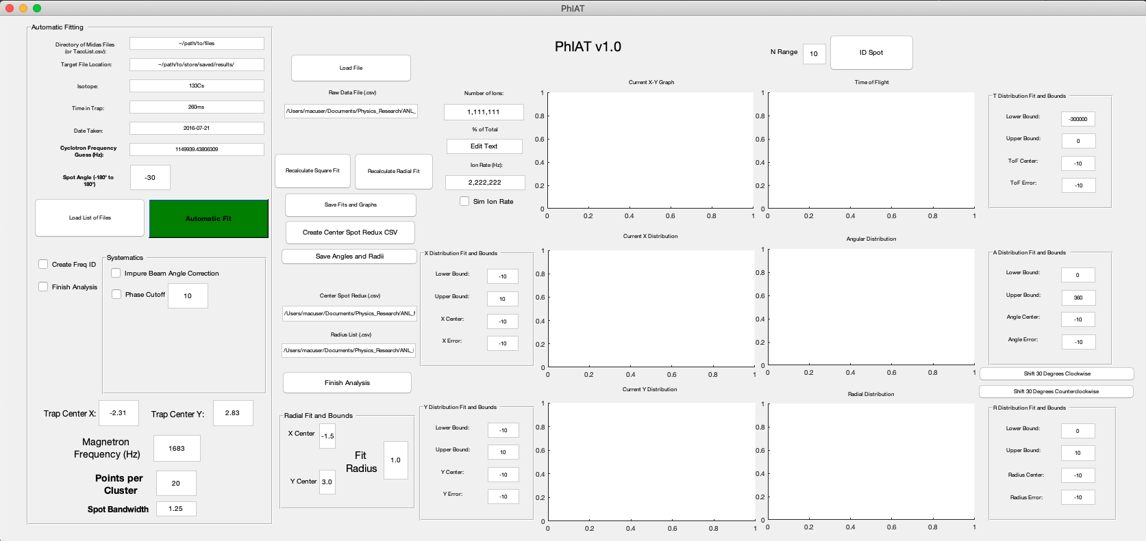
Getting Started
Press the Run Button to bring up the PhIAT GUI:

Slide 7
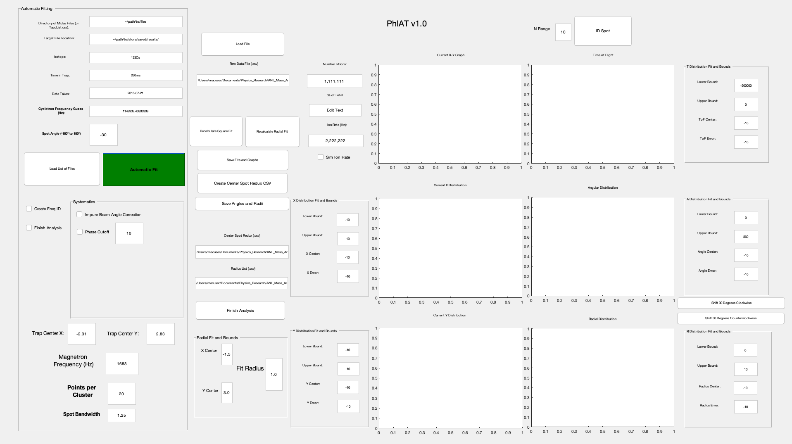
Loading a List of Files
To start, input the address of the directory of MIDAS files (i.e. /Users/wsporter/Documents/Physics_Research/TITAN/PIICR_Analysis/Testing/Test_CAENOffset)
If you have already converted a directory of MIDAS files using midas_to_phiat.py, you can also input the address of the FileList.csv (see midas_to_phiat.py documentation)
Click the Load List of Files button...

Slide 8
Loading a List of Files cont.
Clicking Load List of Files runs midas_to_phiat.py and converts each MIDAS file into a readable .csv file containing (for each event):
X/Y Positions
Times of Flight from Ejection to MCP Contact
What trigger number of the TDC each event was recorded during
midas_to_phiat.py also creates a FileList.csv, which contains a list of addresses of all data files

Slide 9
Loading a List of Files cont.
The FileList.csv is used so PhIAT can navigate to each individual file and then load in that respective data

Slide 10
BEFORE YOU CONTINUE -- Simulated Data
If you are fitting any simulated data (i.e. data produced from PI_ICR_simulated_data.m), make sure the Sim Ion Rate checkbox is checked
Since there is no count timing information from simulated data, leaving this unchecked will cause an error otherwise...

Slide 11
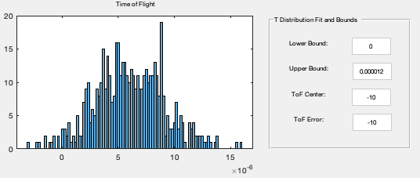
Fitting -- ToF Cuts
It’s advised to apply a time of flight cut to throw away data outside of the expected times of flight (i.e. column 3 of each data .csv)
Press Load File to load just the first file
Using the distribution seen in the ToF plot, determine bounds that cut out data outside of the counts majority
It’s expected the distribution is pseudo-Gaussian
Put these bounds in the Lower Bound and Upper Bound boxes next to the ToF plot

Slide 12
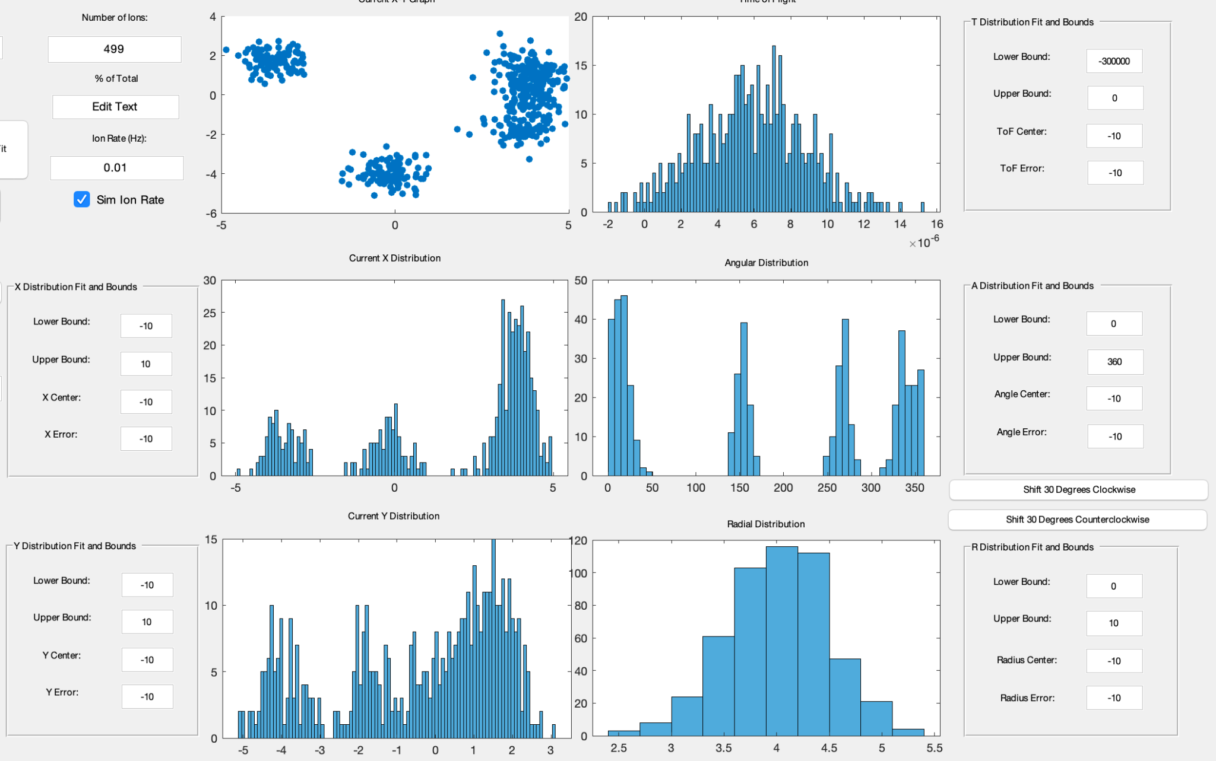
Fitting -- Other Cuts
After pressing Load File, the data and relevant distribution will pop up:

Slide 13
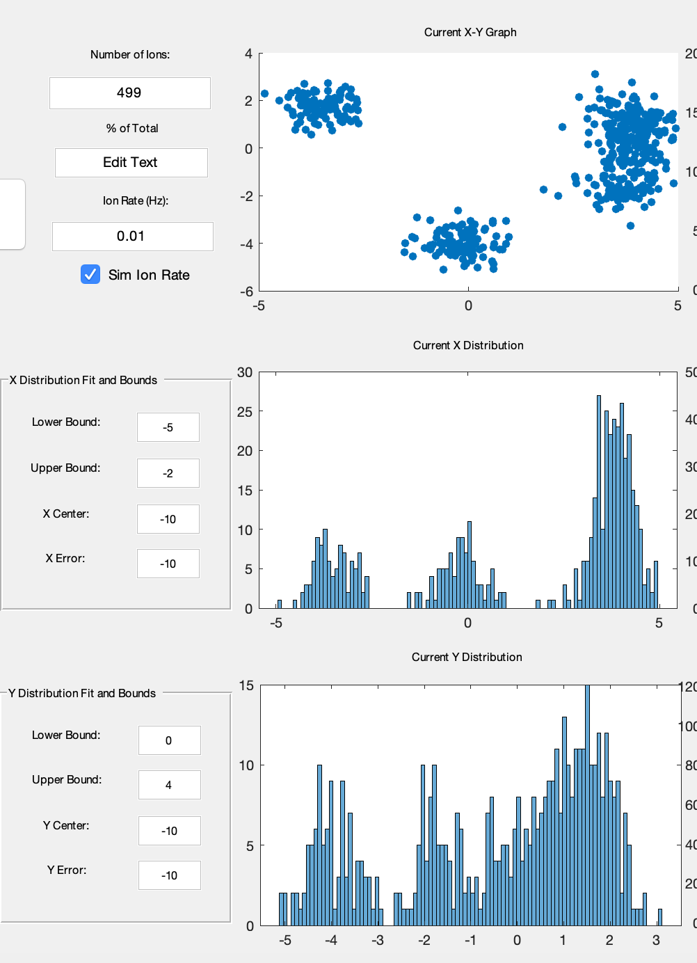
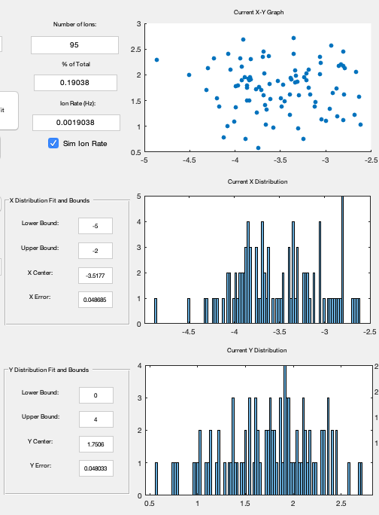
Fitting -- Other Cuts
To fit a spot, input X and Y gates in the respective lower and upper bound boxes to center around a spot
Pressing Recalculate Square Fit will cut out all data outside these bounds
This can also be done to cut out data using the Radial and Angular distributions
NOTE: If at any point you make a mistake while manually gating, you can simply press Load File to restart

Slide 14
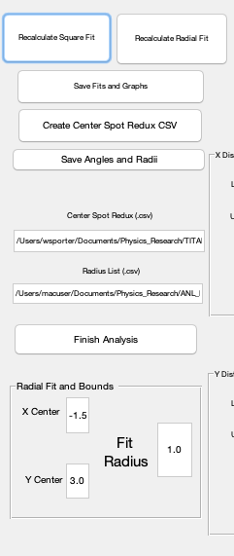
Fitting -- Recalculate Radial Fit
Data can also be cut outside a radius of a specified point
Choose X Center and Y Center to specify the point
Fit Radius: Data outside a radius of this value is cut away
Pressing Recalculate Radial Fit does this cutting

Slide 15
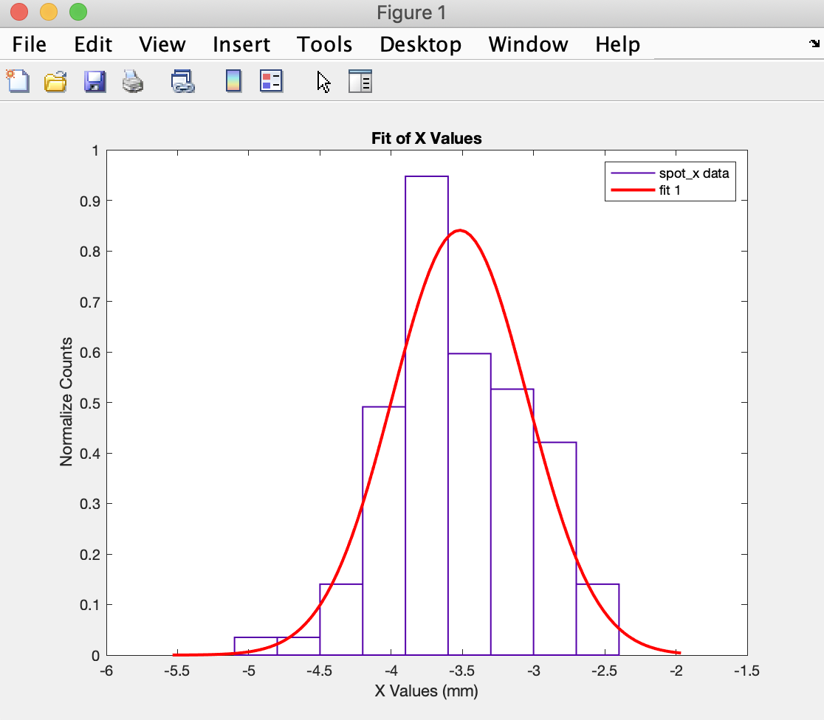
Fitting -- Save Fits and Graphs
Once satisfied with cuts applied, click Save Fits and Graphs
X, Y, Angular, Radial and ToF distributions are fit with a Gaussian using a Maximum Likelihood estimator to determine the spot center
These five fits are printed out, and screenshots are saved in a folder labeled by the Tacc
This folder also contains other Excel files that are used by the script automatically later in analysis
Upon press, the script automatically cycles to the next file in the FileList, so simply press Load File again to load in the next file and continue

Slide 16

Fitting -- Angular Cuts
Since the distribution of angles will be fit, Shift 30 Degrees Clockwise or Counterclockwise can be selected to shift the angular data 30 degrees forward or backwards
This is so the distribution isn’t cut off at 360 and can still be fit reasonably

Slide 17
Finish Analysis
Once all files are fit (when ‘No More Files Left’ appears in the Raw Data File (.csv) box), press Save Angles and Radii and Create Center Spot Redux CSV
This creates a few more Excel files to be used by the code when finishing fitting
In the text box beneath Center Spot Redux (.csv), input the address for the CenterSpotRedux.csv file created (in the directory you specified in Target File Location)
In the text box beneath Radius List (.csv), input the address for the Radii.csv file created (in same directory as above)

Slide 18
Finish Analysis
Press Finish Analysis and the script will automatically finish the rest of the analysis for you!
This is the same as is outlined in Automatic Fitting

Slide 19
Please contact Sam Porter (wporter@triumf.ca) if you have any questions
Happy PI-ICRing!

